Slide 1
Open-Source Orchestration for MLOps
Stefan Nica
snica@suse.com

Slide 2
Agenda
Machine Learning Basics
MLOps Highlights
FuseML Intro
More information
FuseML website: https://fuseml.github.io/
Article series: https://community.suse.com
FuseML @ github: https://github.com/fuseml/fuseml
2

Slide 3
Face
recognition
Object recognition
Speech
recognition
Machine Learning Systems
Handwriting
recognition
Art generation
Text-to-speech
learn from data
identify & reproduce patterns
solve problems that are
mathematically and programmatically difficult
computationally expensive
Fraud
detection
Language
translation
Spam
filtering
Traffic
prediction
Product
recommendation
Medical diagnosis
Weather
prediction
3
3

Slide 4
Training data
ML algorithm (model)
Training & validation
ML Workflow
Trained ML model
A generic machine learning workflow and its main classes of artifacts: data and ML models
Prediction
Input data
Result
4

Slide 5
Model
selection
Raw data
Training data
ML model
Data
preparation
Training & validation
ML Workflow
Trained ML model
Most development effort is around data: acquisition, storing, analysis, cleaning, transformation, validation, feature engineering and selection.
Prediction
Input data
Result
5

Slide 6
Model
selection
Raw data
Training data
ML model
Data
preparation
Training & validation
ML Workflow
Trained ML model
ML development is iterative, exploratory and experimental.
Prediction
Input data
Result
6

Slide 7
7

Slide 8
Model
selection
Raw data
Training data
ML model
Prediction service
Data
preparation
Training & validation
REST API
ML Workflow
Trained ML model
A prediction service is a web microservice that wraps a REST API around the ML model.
Prediction
Serving
Input data
Result
8

Slide 9
Model
selection
Raw data
Training data
ML model
Data
preparation
Training & validation
ML Workflow
Trained ML model
Models can quickly degrade with time.
Specialized monitoring is required to continuously re-evaluate and optimize the model.
Prediction
Serving
Input data
Result
Metrics
Monitoring
9

Slide 10
Model
selection
Raw data
Training data
ML model
Data
preparation
Training & validation
ML Workflow
Trained ML model
Continuous training: continuous model improvement through re-training.
Prediction
Serving
Input data
Result
Metrics
Monitoring
10

Slide 11
Data
preparation
Training & validation
Model
selection
Feature store
Model
store
ML Metadata
store
ML Workflow
Specialized components for storing and versioning data and ML models.
A store for recording metadata related to the workflows.
Prediction
Serving
Input data
Result
Metrics
Monitoring
11

Slide 12
Data
preparation
Training & validation
Model
selection
Feature store
Model
store
ML Metadata
store
ML Workflow
Specialized components for storing and versioning data and ML models.
A store for recording metadata related to the workflows.
Prediction
Serving
Input data
Result
Metrics
Monitoring
12

Slide 13
Data
preparation
Training & validation
Model
selection
Automated
Pipelines
Feature store
Model
store
ML Metadata
store
ML Workflow
Automated pipelines for continuous delivery,
deployment, monitoring
and training
Prediction
Serving
Input data
Result
Metrics
Monitoring
13

Slide 14
Data Engineers
ML Engineers
Data
preparation
Training & validation
Model
selection
Automated
Pipelines
Data/Business Analysts
Feature store
Model
store
ML Metadata
store
Software Engineers
Data Scientists
ML Workflow
DevOps Engineers
Specialized tools, skills, experience, and collaboration of various roles.
Prediction
Serving
Input data
Result
Metrics
Monitoring
14

Slide 15
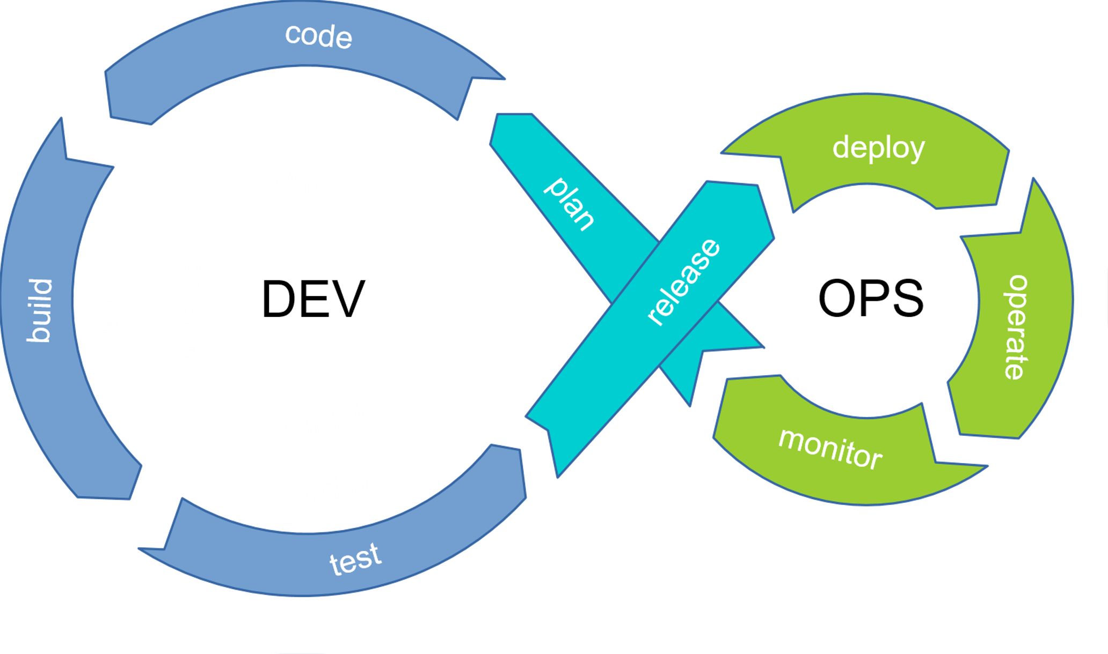
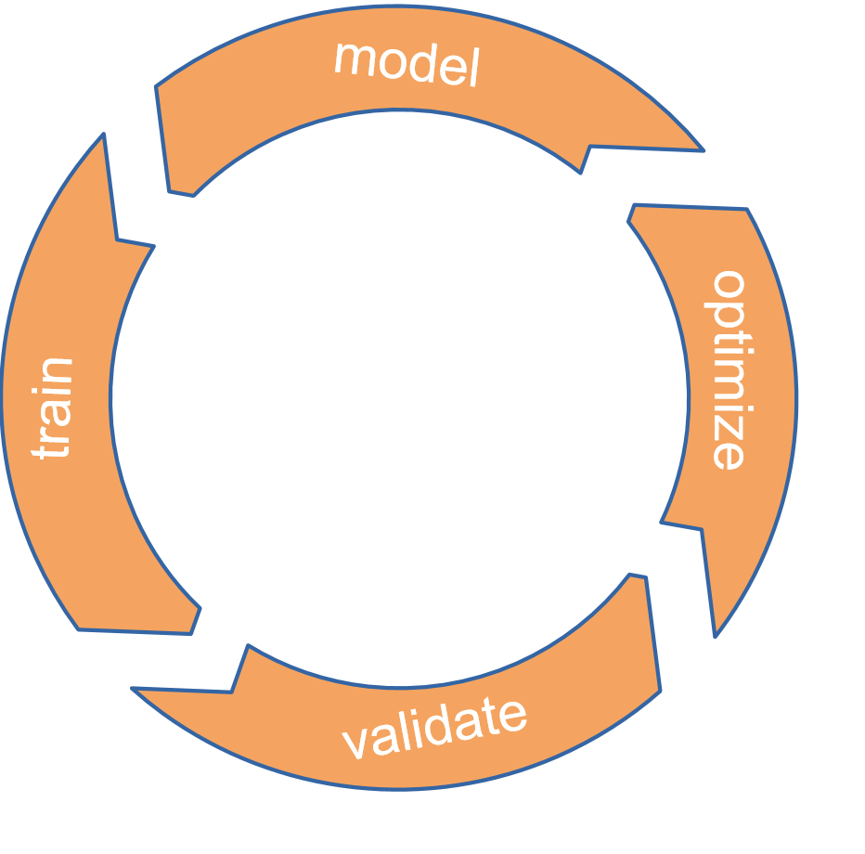
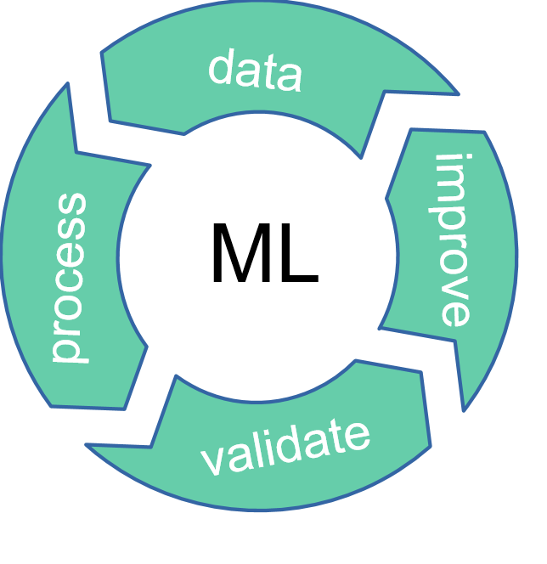
MLOps
ML projects have specialized lifecycles
Broader team skills
Experimentation
CI: also testing and validating data and models
CD: automation for training and serving models
CT (Continuous Training): automatically retraining/serving models
15

Slide 16
FuseML
Gitea
Docker
Registry
Orchestration framework for MLOps
Cloud-native application
Tekton
16

Slide 17
FuseML
Gitea
Docker
Registry
Orchestration framework for MLOps
Cloud-native application
Open, extensible integration framework
Katib
Tekton
17

Slide 18
Data
preparation
Training & validation
Prediction
Serving
Monitoring
FuseML
Gitea
Docker
Registry
Orchestration framework for MLOps
Cloud-native application
Open, extensible integration framework
Automated workflows
Katib
Tekton
18

Slide 19
Data
preparation
Training & validation
Prediction
Serving
Monitoring
Katib
FuseML
Gitea
Docker
Registry
Orchestration framework for MLOps
Cloud-native application
Open, extensible integration framework
Automated workflows
Tekton
19

Slide 20
Data
preparation
Training & validation
Prediction
Serving
Monitoring
Katib
FuseML
Gitea
Docker
Registry
Orchestration framework for MLOps
Cloud-native application
Open, extensible integration framework
Automated workflows
Tekton
20

Slide 21
Data
preparation
Training & validation
Prediction
Serving
Monitoring
FuseML
Gitea
Docker
Registry
Orchestration framework for MLOps
Cloud-native application
Open, extensible integration framework
Automated workflows
Katib
Tekton
21

Slide 22
Data
preparation
Training & validation
Prediction
Serving
Monitoring
FuseML
Gitea
Docker
Registry
Orchestration framework for MLOps
Cloud-native application
Open, extensible integration framework
Automated workflows
Ecosystem of MLOps recipes
Katib
Tekton
22

Slide 23
Resources
FuseML website: https://fuseml.github.io/
Article series: https://community.suse.com
FuseML @ github: https://github.com/fuseml/fuseml
Slack: https://join.slack.com/t/fuseml/shared_invite/zt-rcs6kepe-rGrMzlj0hrRlalcahWzoWg
We welcome feedback and opensource contributions !
23

Slide 24
Thank you
24

